Slide 1

enzymatic processes in industrial production and its application
(enzyme: rennet)
BY : MANAS YUVRAJ SURYAVANSHI
P COMPS

Slide 2
1
ENZYME
2
RENNET
INDUSTRIAL APPLICATION AND PROCESS
CONTENTS
3
4
ROLE AS A COMPUTER ENGINEER FOR IMPROVING THE INDUSTRY
5
BIBLIOGRAPHY

Slide 3
ENZYME
An enzyme is a protein that acts as a biological catalyst, accelerating chemical reactions without being consumed in the process. The molecules on which enzymes act are called substrates, which are converted into products. Nearly all metabolic processes within a cell depend on enzyme catalysis to occur at biologically relevant rates.
Enzymes increase the reaction rate by lowering a reaction’s activation energy, often by factors of millions. Enzymes do not affect the overall equilibrium of a reaction and are regenerated at the end of each cycle.
Enzymes have widespread practical applications. In industry, they are used to catalyze the production of antibiotics and other complex molecules. In everyday life, enzymes in biological washing powders break down protein, starch, and fat stains, enhancing cleaning performance.

Slide 4
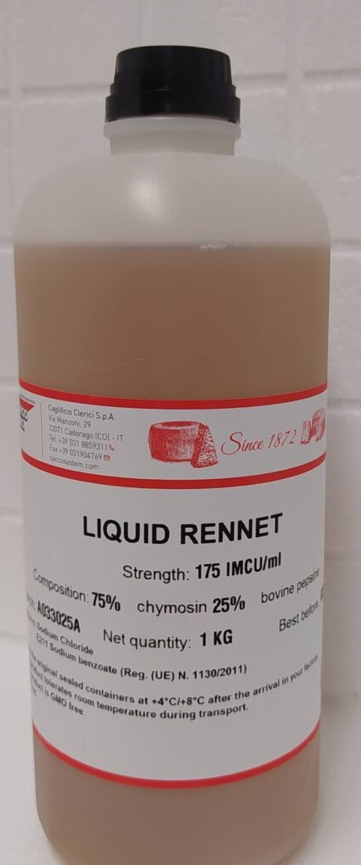
RENNET
Rennet is an enzyme derived typically from the lining of the fourth stomach of young ruminant animals like goat, lambs, calves, etc. It is only found in the young animals which still depend on milk as their basic source for food.
Apart from animals, evidence suggests that this enzyme is also present in certain plants such as artichokes, nettles, etc. The enzyme from plant source is often used for making cheese for vegetarian diet.
Casein is one of the main proteins in milk and the action of rennet enzyme causes this protein to fuse with other casein molecules thereby forming a network and causing milk coagulation.

Slide 5
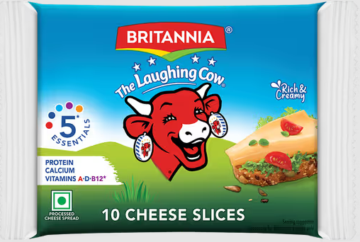
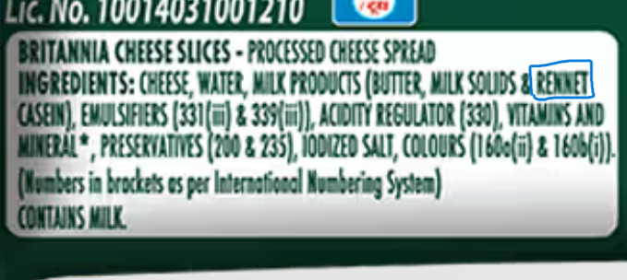
INDUSTRIAL APPLICATION OF RENNET - CHEESE
Cheese is an extensively consumed fermented dairy product with a growing consumer demand. More than a hundred varieties of cheese are produced in the world. It is an excellent dietary source of protein, vitamins, and minerals such as calcium. The variety of cheese depends on the type of milk, the animal’s diet, the butter fat content, bacteria and mold, and the processing and aging conditions of cheese. The use of the rennet enzyme in cheese production is one of the major applications of enzymes in food processing. Rennet acts on the milk protein in two stages, by enzymatic and by nonenzymatic action that results in coagulation of milk.
02 Enter title
Click here to add content of the text，and briefly explain your point of view

Slide 6
INDUSTRIAL PROCESS OF RENNET - CHEESE
STEP 1:
Use skim or whole milk for making cheese.
STEP 2:
Heat milk to 90°F-95°F (30°C).
STEP 3:
Add rennet and stir well to evenly distribute it.
STEP 4:
Let the milk mixture rest undisturbed for about an hour until it gels into curds.
STEP 5:
Cut the curds horizontally and vertically with 1/2-inch spacing.
STEP 6:
Gently heat the curds to 100°F (30°C) for a soft cheese or 100°F-105°F for a harder cheese.
02 Enter title
Click here to add content of the text，and briefly explain your point of view

Slide 7
STEP 7:
Using colander strain the whey from the curd.
STEP 8:
Crumble the curds by adding salt.
STEP 9:
Keep the cheese at the room temperature for several days for it to age.
STEP 10:
Now the cheese is ready to comsume.
02 Enter title
Click here to add content of the text，and briefly explain your point of view

Slide 8
ROLE AS COMPUTER ENGINEER FOR IMPROVING THE INDUSTRY
For many cheese technologists at industrial cheese factories it is a weekly recurring ritual: determining the optimal process settings for the cheese factory for the upcoming week.This is due to the varying composition of the milk that is used to make the cheese. The composition of the milk varies depending on its source and is influenced by factors such as the seasons and specific weather conditions.
Despite these fluctuations in milk quality, the goal is always to produce cheese of consistent quality and maximize yield. This means the production process must be continuously adjusted to the quality of the incoming milk.Therefore, many cheese manufacturers conduct a weekly analysis of current and historical data. Based on this analysis, they calculate the process settings for the production lines for the coming week to achieve optimal quality and yield.
02 Enter title
Click here to add content of the text，and briefly explain your point of view

Slide 9
By combining the data gathered from the cheese manufacturers along with our knoweledge of artificial intelegence we can create a tool that not only enhances efficiency but also preserve the art of maiking cheese.
02 Enter title
Click here to add content of the text，and briefly explain your point of view

Slide 10
BIBLIOGRAPHY
Enzyme:
https://en.wikipedia.org/wiki/Enzyme
Rennet:
https://www.sciencedirect.com/topics/agricultural-and-biological-sciences/rennet
https://www.innolact.fi/wp-content/uploads/2020/10/liquidrennet75_25.jpg
Industrial Application of Rennet:
https://www.sciencedirect.com/topics/agricultural-and-biological-sciences/rennet
https://instamart-media-assets.swiggy.com/swiggy/image/upload/fl_lossy,f_auto,q_auto,h_600/NI_CATALOG/IMAGES/CIW/2025/5/28/8fb22958-0c7e-4200-b7e3-258c4e39956c_1604_1.png
https://instamart-media-assets.swiggy.com/swiggy/image/upload/fl_lossy,f_auto,q_auto/NI_CATALOG/IMAGES/CIW/2025/5/28/f6e09189-8bb5-4c22-b01b-ecd9a152e1ca_1604_2.png

Slide 11
Industrial Process of Cheese:
https://cycheese.com/article/how-to-make-cheese-using-rennet#:~:text=In%20this%20guide%2C%20we%20will%20cover%20the%20essential,the%20type%20of%20cheese%20you%20want%20to%20make.
Role as Computer Engineer for Improving the Industry:
https://hai.nl/news/artificial-intelligence-optimizing-cheeseproduction/#:~:text=Optimize%20the%20production%20process%20to%20predictable%20consistent%20quality%2C,A%20real-time%20dashboard%20with%20adjustment%20advice%20for%20operators.
https://www.dairyprocessing.com/articles/2177-ai-solution-developed-to-improve-cheese-yields
02 Enter title
Click here to add content of the text，and briefly explain your point of view

Slide 12
thank you

